Slide 1

AI Exam Proctoring System
Submitted by:
Anosh Ashraf (F24BSE019)
Amna Mustafa Alwani (F24CSC048)
Department of Software Engineering/Computer Science, Faculty of Information Technology Salim Habib University.
Supervisor: Ms. Sadia Karim.

Slide 2
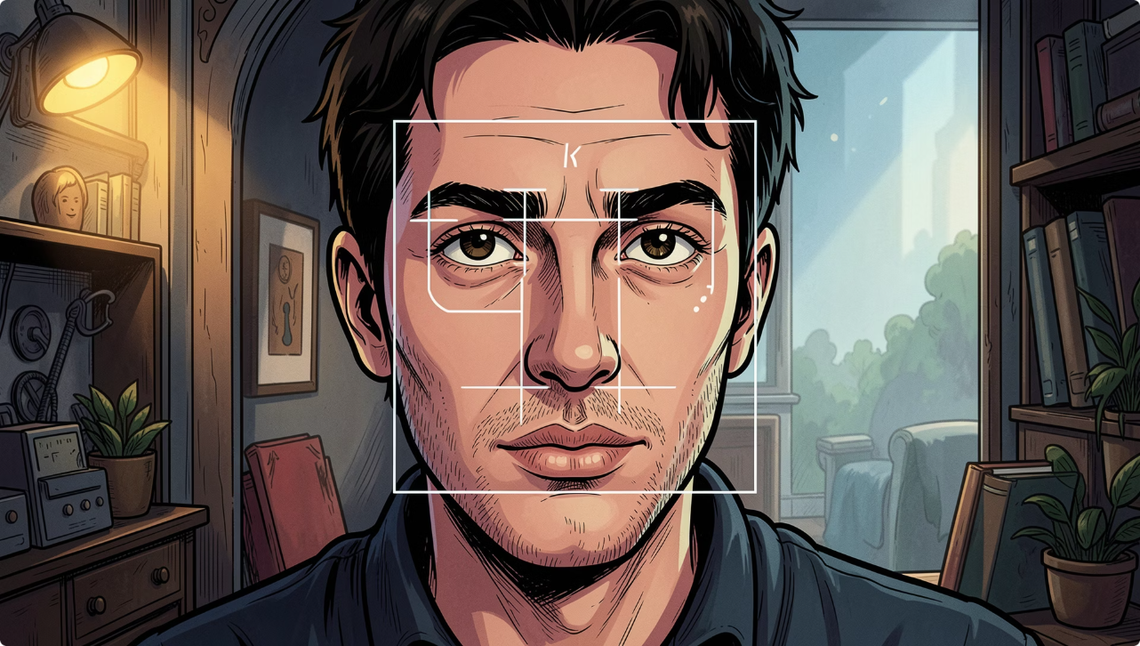

Executive Summary
This project presents an AI Exam Proctoring System implemented in Java with a JavaFX interface and OpenCV for real-time computer vision. It performs face and eye detection, head-movement tracking, multi-face identification, automatic screenshot capture, logging, and PDF report generation.
Objectives: monitor students during remote exams, detect suspicious behaviour, preserve evidence automatically, and support institutional review.
Theme accent: use #F5A3A3 for alerts and emphasis in UI and report headers.

Slide 3


System Architecture & Workflow
Camera Activation
Frame Capture
Face & Eye Detection
Movement Analysis
Evidence Storage
Input → Webcam Activation → Frame Capture → Detection (Haar Cascades) → Behavior Analysis → Alerting & Evidence Storage → PDF Report generation. Modular layers separate capture, processing, logging, and UI to improve maintainability and testing.

Slide 4
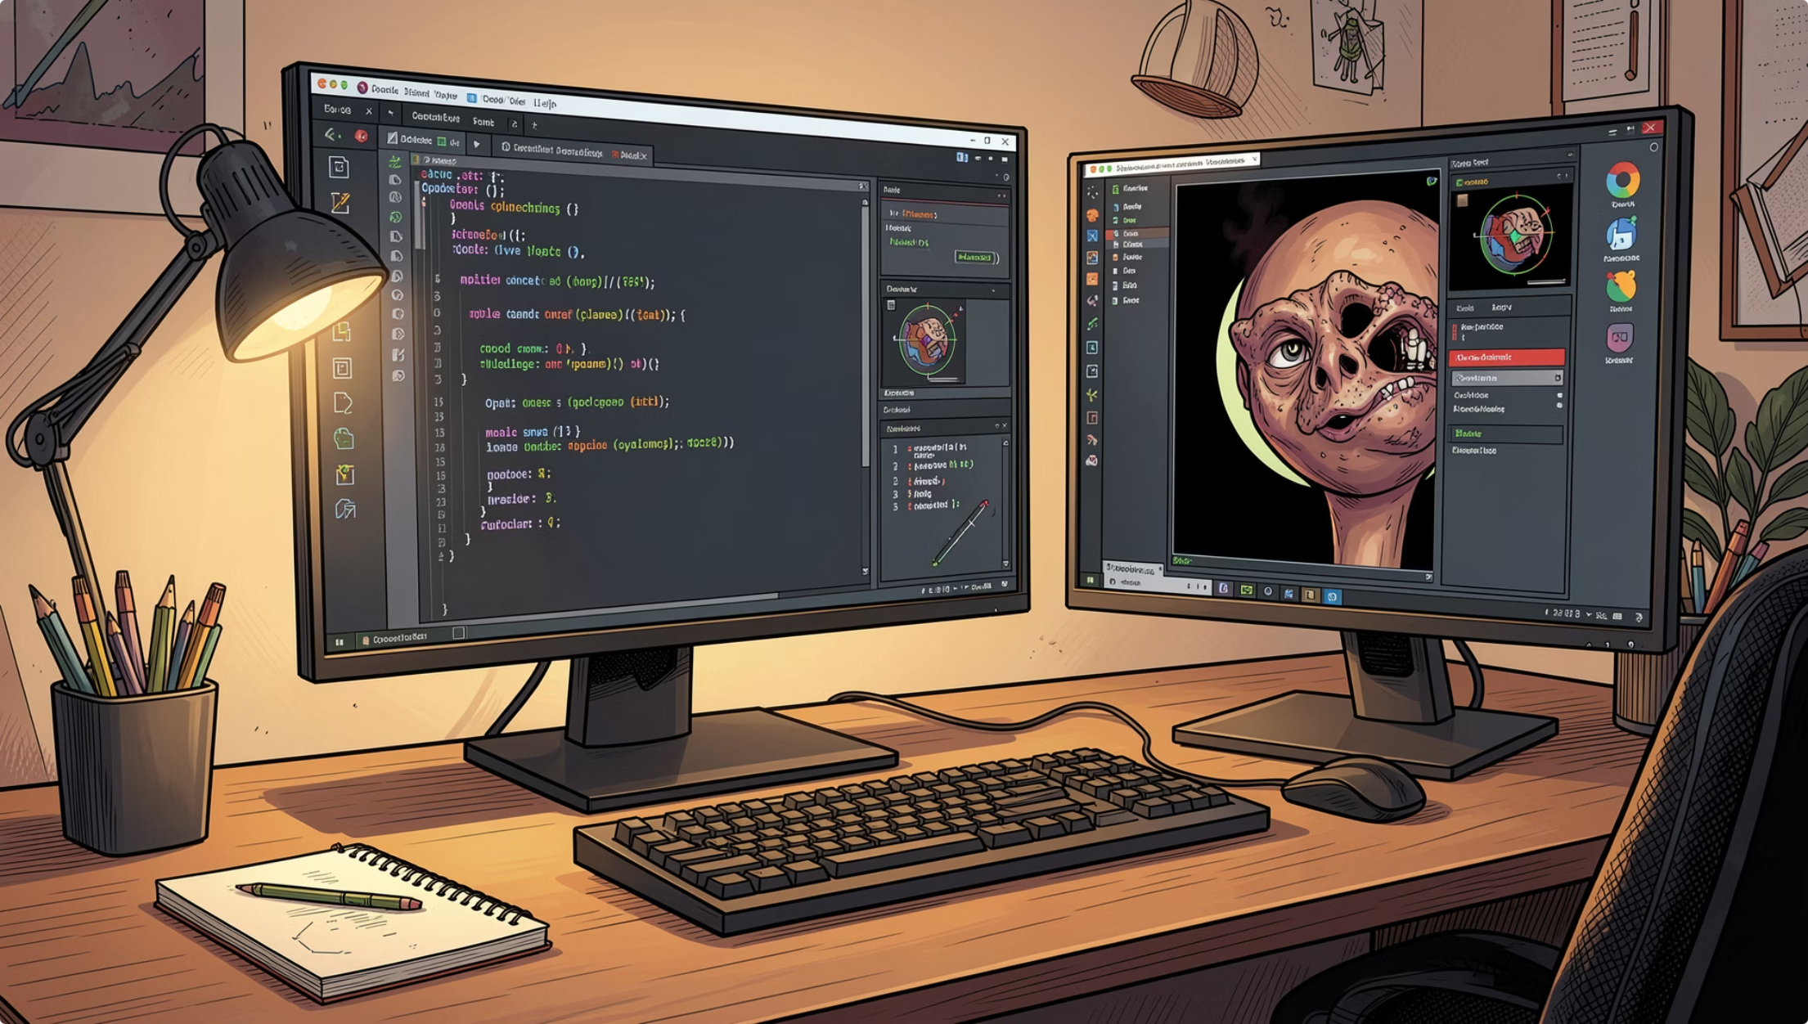
Core Methods & Implementation Details
Programming Stack
Java (JDK 17), JavaFX (UI), OpenCV (CV), iText (PDF), IntelliJ IDEA (IDE)
Detection Algorithms
Haar Cascade classifiers for face and eye detection—chosen for speed and lightweight, suitable for real-time desktop use.
Evidence & Reports
Automated screenshots with timestamps, structured logs, and consolidated PDF reports for examiner review.

Slide 5
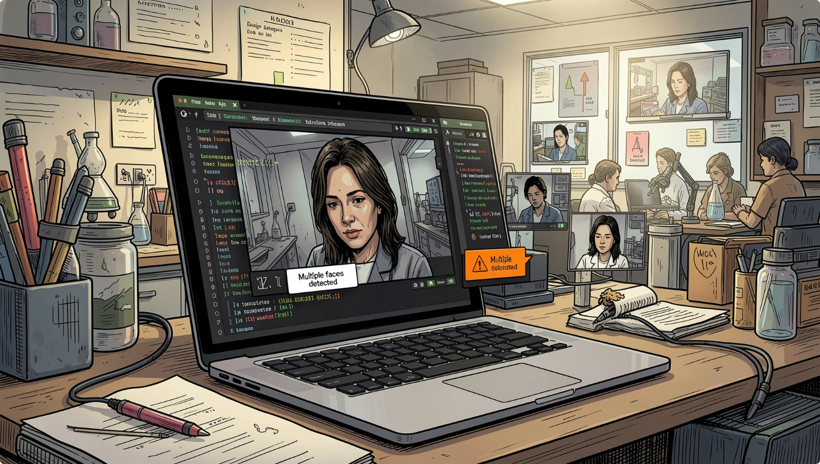
Evaluation, Results & Limitations
Testing summary: Camera detection, face detection, eye detection, screenshot saving, logging, and PDF generation passed functional tests. The system reliably flagged:
No face detected
Eyes not visible
Repeated looking-around (excessive horizontal movement)
Multiple faces in frame
Limitations observed: variable lighting degrades accuracy; Haar Cascades can produce false positives/negatives under occlusion; desktop-only—no cloud dashboard or LMS integration yet.

Slide 6

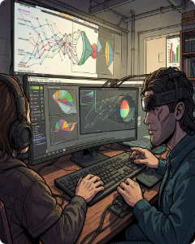

Conclusions, Future Work & Project Artefacts
Conclusion: The AI Exam Proctoring System demonstrates a practical, modular approach to improving remote exam integrity using real-time CV on desktop platforms. It provides immediate alerts and durable evidence for academic review.
Cloud Integration
ML Behaviour Prediction
Extensions
Store logs and screenshots centrally for longitudinal analysis and scalability.
Mobile support, multi-camera monitoring, voice/activity analytics, LMS integration, and authentication mechanisms.
Train models to reduce false alerts and enable predictive detection of suspicious patterns.

Slide 7
Thank You
For your attention and valuable insights.
Anosh Ashraf & Amna Mustafa Alwani
Salim Habib University

